Slide 1
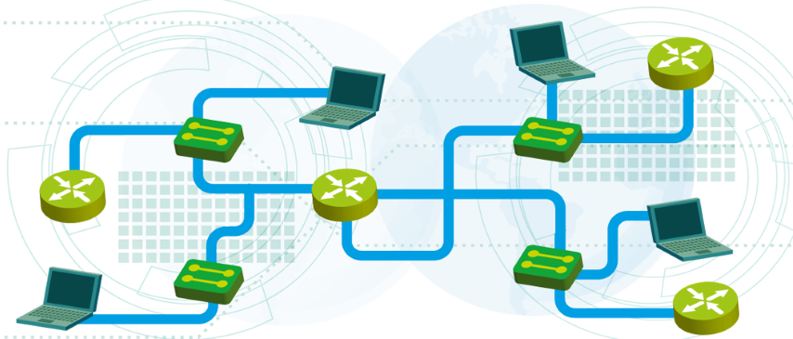

IP Services and Basic Routing
Module 5
SoftUni Team
Technical Trainers
Software University
http://softuni.bg

Slide 2
Questions
sli.do #NetFund

Slide 3
Table of Contents
IP services: DHCP and DNS
Introduction to routing
Direct routing
Inter-VLAN routing
Static routing

Slide 4
IP services: DHCP and DNS

Slide 5
What is DHCP?
DHCP: Dynamic Host Configuration Protocol
Provides automatic distribution of IP addresses and other networking parameters such as:
Subnet mask
Default gateway
DNS servers
More…
Industry standard

Slide 6
Why use DHCP?
Reduces the administration efforts
Easy to use from the clients
Decreases the risk of IP address duplication
Can provide additional network information
DHCP fingerprinting

Slide 7
When NOT to use DHCP
Static IP configurations may be preferred for:
Servers
Network devices (switches, routers, etc.)
Printers
Admin stations
Very small networks may prefer not to use DHCP at all

Slide 8
DHCP Reservations
Alternative way to have “static” addresses with DHCP: DHCP reservations
The server gives the same IP address to the same client (MAC address) each time
Examples:
Always assign 192.168.1.100 to 37-25-AE-6C-0C-7F
Always assign 192.168.1.200 to 41-AA-7E-21-31-54

Slide 9
DHCP Components
Server
DHCP scope - range of addresses (pool), lease time, reservations, etc.
Uses port UDP 67
Client
Must be configured to use DHCP
Uses port UDP 68
(Relay agent)
Used to serve multiple (V)LANs with a single DHCP server

Slide 10
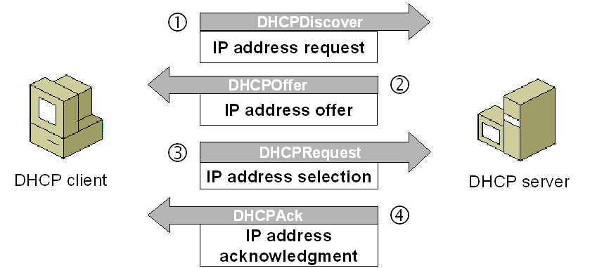
The DHCP Process
“DORA”
Discover
Offer
Request
Acknowledge
All messages use broadcast (IPv4)

Slide 11
DHCP Relay
Two facts about the DHCP operation and the (V)LANs:
DHCP uses broadcast and this is limited to a single (V)LAN
Multiple (V)LANs = multiple broadcast domains
So how to use DHCP in multiple (V)LANs?
Two options to serve clients from multiple broadcast domains:
Use a separate DHCP server in each (V)LAN
Use DHCP relay

Slide 12
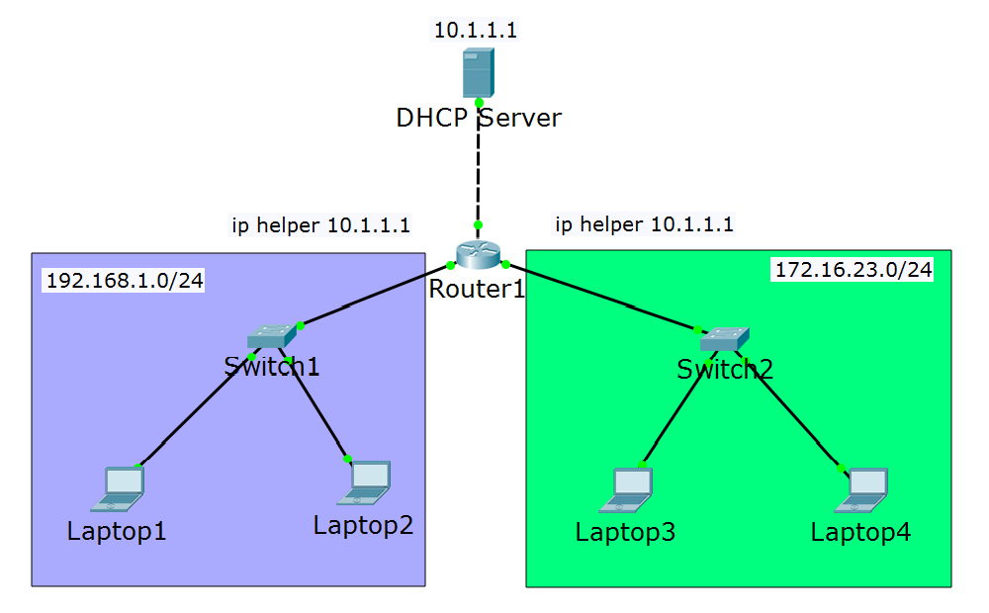
DHCP Relay (2)
Scope settings for 192.168.1.0/24
Scope settings for 172.16.23.0/24

Slide 13
DNS Introduction
DNS: Domain Name System
DNS Usage:
To translate names to IP addresses
To translate IP addresses to names
To find a particular service in the network
*DNS will be discussed in more details in the advanced course

Slide 14
DNS “A” Records
One of the most commonly used records in DNS
Matches a hostname (or FQDN) to an IP address
Examples:
pc1 -> 192.168.1.1
pc2 -> 192.168.1.2
server -> 192.168.1.100
www.abv.bg -> 194.153.145.104
*FQDN = Fully Qualified Domain Name

Slide 15
DNS: Client-to-Server Communication
The clients need to know the address of their DNS server(s)
It can be either:
Statically configured
OR
Dynamically received from a DHCP server
DNS uses server port 53 (both udp and tcp)

Slide 16
Questions
sli.do #NetFund

Slide 17
Introduction to routing

Slide 18
Switching vs Routing
Switches:
Use Layer 2 information (MAC addresses)
Forwarding decisions based on the MAC address tables
Not scalable for big networks
Routers:
Use Layer 3 information (IP addresses)
Forwarding decisions based on the routing tables
Scalable for large networks

Slide 19
What is required for routing?
If a destination IP address is not local, the sending device consults its routing table
The routing table has entries which describe:
Which is the destination network?
How to reach it?
Example:
192.168.1.0/24 via 10.1.1.1
Destination network
How to reach it

Slide 20
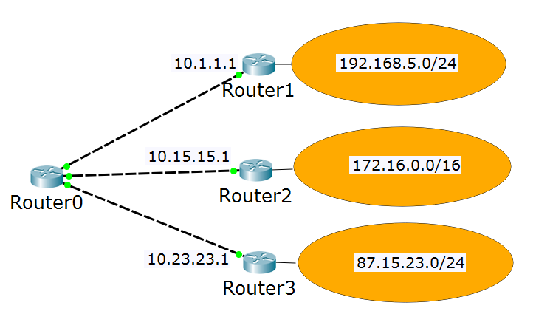
The Routing Table
My routing table:
192.168.5.0/24 via 10.1.1.1
172.16.0.0/16 via 10.15.15.1
87.15.23.0/24 via 10.23.23.1
10.1.1.0/24 is local
10.15.15.0/24 is local
10.23.23.0/24 is local
10.1.1.100
10.15.15.100
10.23.23.100

Slide 21
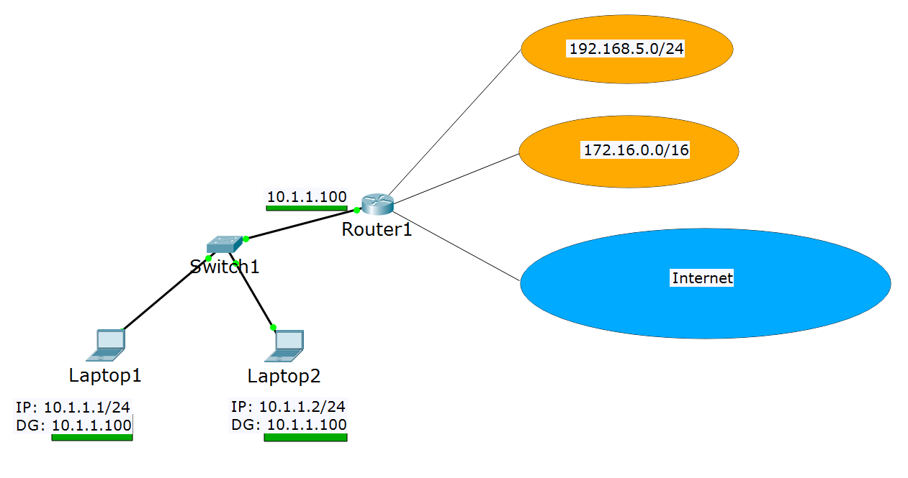
Default Gateway

Slide 22
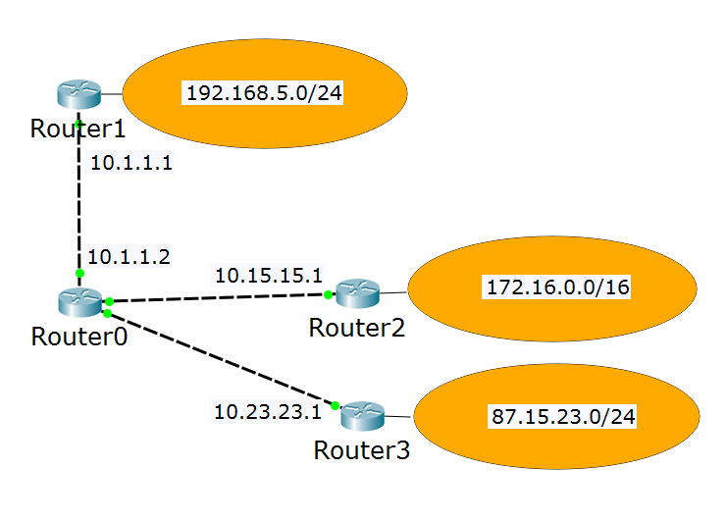
Default Gateway (2)
My routing table:
192.168.5.0/24 is local
10.1.1.0/24 is local
172.16.0.0/16 via 10.1.1.2
87.15.23.0/24 via 10.1.1.2
10.15.15.0/24 via 10.1.1.2
10.23.23.0/24 via 10.1.1.2
OR
192.168.5.0/24 is local
10.1.1.0/24 is local
0.0.0.0/0 via 10.1.1.2 (default gateway)

Slide 23
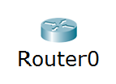
The Rule of the Longest Match
192.168.0.0/16 via 10.1.1.1
192.168.5.0/24 via 10.15.15.1
0.0.0.0/0 via 10.23.23.1
How do I reach 192.168.5.3?
How do I reach 192.168.18.7?
How do I reach 85.12.3.42?
Answer: via 10.15.15.1
Answer: via 10.1.1.1
Answer: via 10.23.23.1

Slide 24
Direct routing

Slide 25
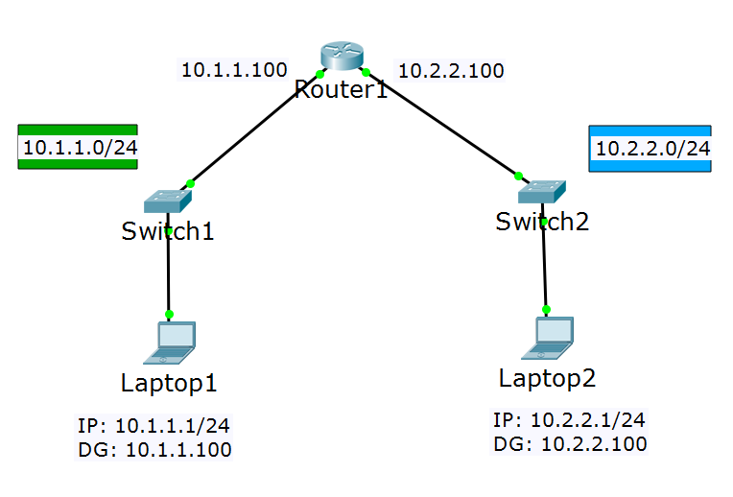
Direct routing

Slide 26
Inter-VLAN routing

Slide 27
How to Route Between VLANs
To route between two or more VLANs, a Layer 3 device is required (Router or L3 switch)
Inter-VLAN routing can be done either with
The same switch which holds the VLANs (if it is L3)
External L3 switch
External router
Only IP addresses (one per VLAN) and no other static or dynamic routing configuration is required

Slide 28
Inter-VLAN Routing Using the Same Switch
The switch must have L3 functionality
Configurations required:
One IP address per VLAN
Default gateway on the end devices

Slide 29
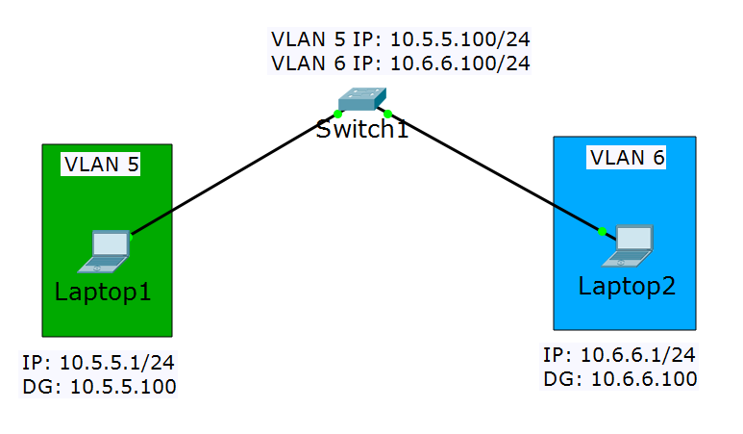
Inter-VLAN Routing Using the Same Switch (2)

Slide 30
Inter-VLAN Routing Using External Switch
The external switch must have L3 functionality
Configurations required:
Trunk ports for the switch-to-switch connection
One IP address per VLAN on the external switch
Default gateway on the end devices

Slide 31
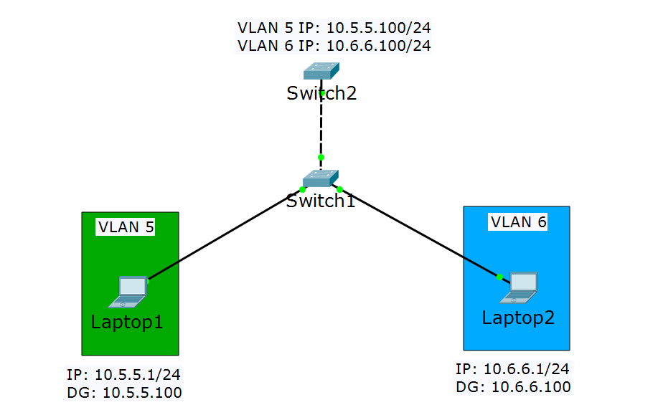
Inter-VLAN Routing Using External Switch (2)
Trunk ports

Slide 32
Inter-VLAN Routing Using External Router
Known as “Router on a stick” or “One-armed router”
Configurations required:
Trunk port on the switch
Sub-interfaces on the router (with “encapsulation dot1Q vlan”)
One IP address per sub-interface
Default gateway on the end devices

Slide 33
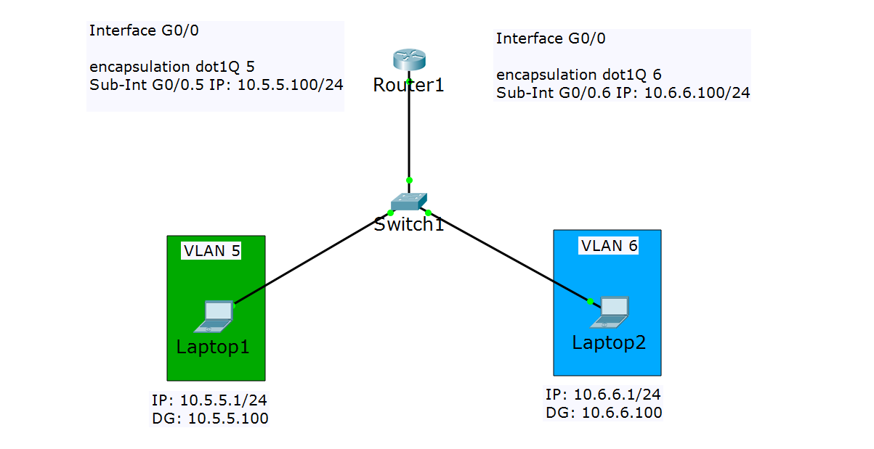
Inter-VLAN Routing Using External Router (2)
Trunk port

Slide 34
Questions
sli.do #NetFund

Slide 35
Static routing

Slide 36
Direct vs indirect Routing
Directly connected networks (or VLANs) does not require static or dynamic routing configuration
To reach remote networks, entries in the routing tables must be added – this is known as indirect routing
The routing table can be updated
Statically (manual configuration)
Dynamically (requires routing protocol like OSPF)

Slide 37
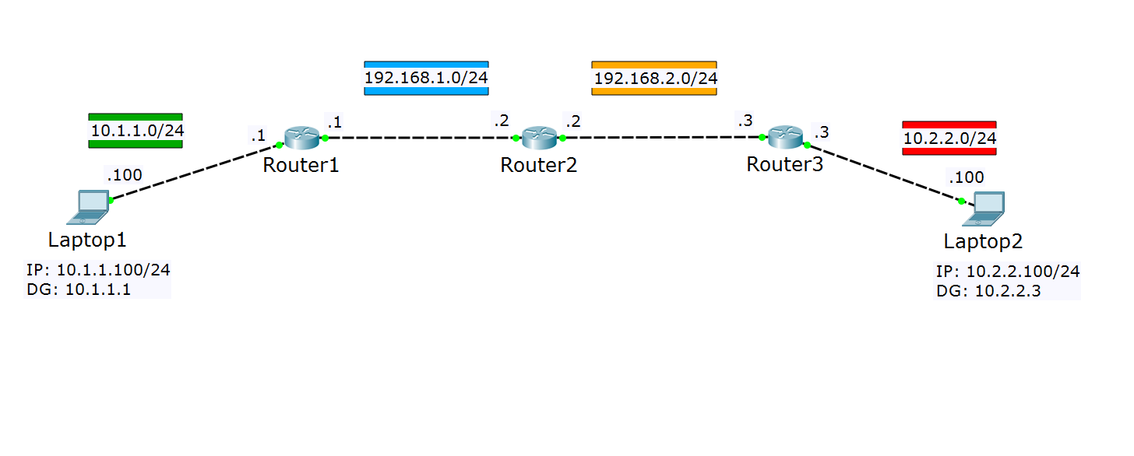
Static Routes
10.1.1.0/24 is local
192.168.1.0/24 is local
192.168.1.0/24 is local
192.168.2.0/24 is local
192.168.2.0/24 is local
10.2.2.0/24 is local
192.168.2.0/24 via 192.168.1.2
10.2.2.0/24 via 192.168.1.2
10.1.1.0/24 via 192.168.1.1
10.2.2.0/24 via 192.168.2.3
10.1.1.0/24 via 192.168.2.2
192.168.1.0/24 via 192.168.2.2

Slide 38
Questions
sli.do #NetFund

Slide 39
Demonstration

Slide 40
Questions
sli.do #NetFund

Slide 41

Summary
IP services: DHCP and DNS
Introduction to routing
Direct routing
Inter-VLAN routing
Static routing
…
…
…

Slide 43






СофтУни диамантени партньори

Slide 44






СофтУни диамантени партньори

Slide 45





Trainings @ Software University (SoftUni)
Software University – High-Quality Education, Profession and Job for Software Developers
softuni.bg
Software University Foundation
http://softuni.foundation/
Software University @ Facebook
facebook.com/SoftwareUniversity
Software University Forums
forum.softuni.bg

